Slide 1
Allowing others to run your code

Slide 2
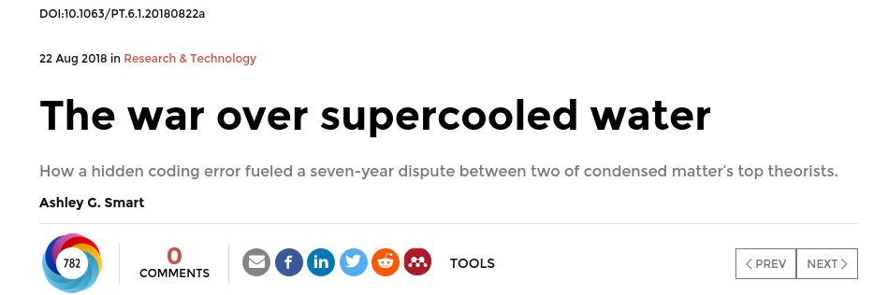
https://physicstoday.scitation.org/do/10.1063/pt.6.1.20180822a/full/

Slide 3
“One of the real travesties,” he says, is that “there’s no way you could have reproduced [the Berkeley team’s] algorithm—the way they had implemented their code—from reading their paper.” Presumably, he adds, “if this had been disclosed, this saga might not have gone on for seven years.”

Slide 4
The reuse battle is won before it is fought.
Select & use good practices consistently throughout development,
not just at the end.
https://github.com/carpentries-incubator/python-intermediate-development

Slide 5
Options:
Let them take a copy and run it themselves on their own machine
Let them take an environment and a copy, then run it themselves on their own machine
Let them run it on another machine

Slide 6
Let them take a copy and run it themselves on their own machine
Benefits
Versioning
Remotely hosted
Can be on-prem or cloud
Limit access or OS
You need to make it reusable

Slide 7
Documentation
README.md
Title
Main features
Installation/deployment: step-by-step instructions for setting up the software so it can be used
Basic usage: step-by-step instructions that cover using the software to accomplish basic tasks
Contributing: for those wishing to contribute to the software’s development, this is an opportunity to detail what kinds of contribution are sought and how to get involved
Contact information/getting help: which may include things like key author email addresses, and links to mailing lists and other resources
Credits/Acknowledgements: where appropriate, be sure to credit those who have helped in the software’s development or inspired it
Citation: particularly for academic software, it’s a very good idea to specify a reference to an appropriate academic publication so other academics can cite use of the software in their own publications and media. You can do this within a separate CITATION text file within the repository’s root directory and link to it from the markdown
Licence: a short description of and link to the software’s licence
https://github.com/carpentries-incubator/python-intermediate-development
Notes:
documentation…
Helps bring new staff researchers and developers up to speed quickly with using the software
Functions as a great aid to research collaborations involving software, where those from other teams need to use it
When well written, can act as a basis for detailing algorithms and other mechanisms in research papers, such that the software’s functionality can be replicated and re-implemented elsewhere
Provides a descriptive link back to the science that underlies it. As a reference, it makes it far easier to know how to update the software as the scientific theory changes (and potentially vice versa)
Importantly, it can enable others to understand the software sufficiently to modify and reuse it to do different things

Slide 8
Let them take an environment and a copy, then run it themselves on their own machine
Benefits
Versioning
Remotely hosted
Can be on-prem or cloud
Limit access or OS
You need to make it reusable
Benefits
Repeatable and specified environment
No dependency hell
Isolation
Speed

Slide 9

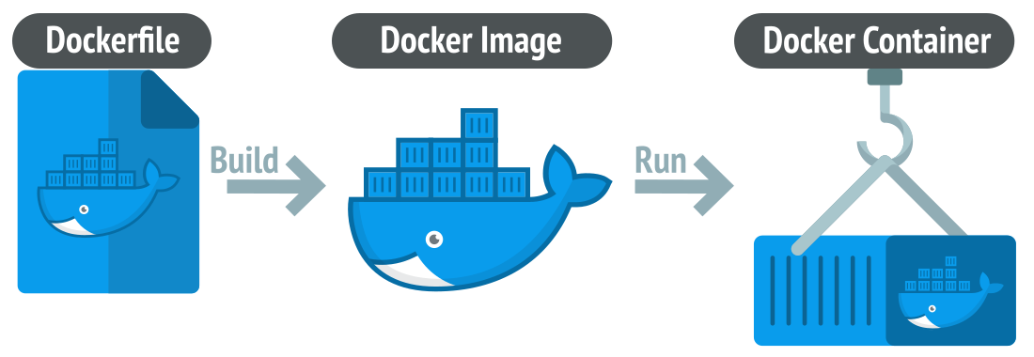

Slide 10
Let them run it on another machine
Benefits
Versioning
Remotely hosted
Can be on-prem or cloud
Limit access or OS
You need to make it reusable
Benefits
Repeatable and specified environment
No dependency hell
Isolation
Speed
Benefits
Shareable
Run anywhere

Slide 11
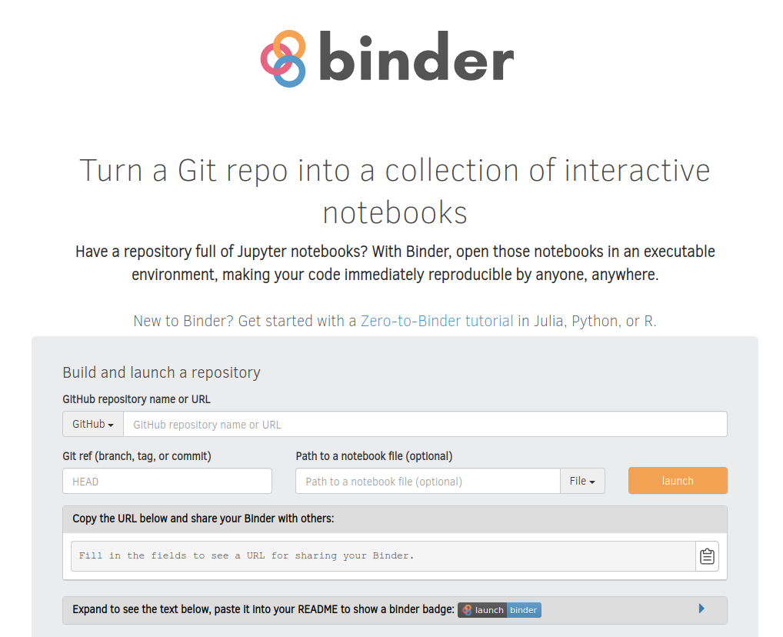
mybinder.com
Notes:
Exercise: take your repo and paste into binder

